Slide 1
Decision Tree
By: Sean Lee

Slide 2
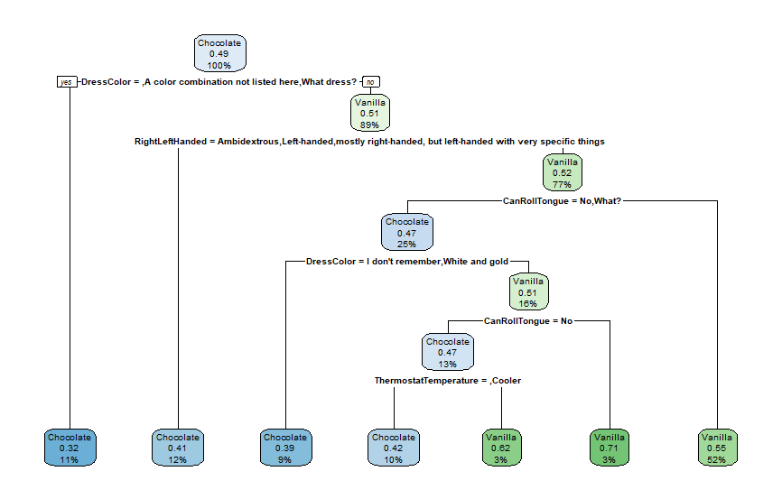
Tree 1: Chocolate Or Vanilla
Dependent Variable: ChocolateOrVanilla
Independent Variables:
DressColor
CanRollTongue
RightLeftHanded
ThermostatTemperature
Relative Error:

Slide 3
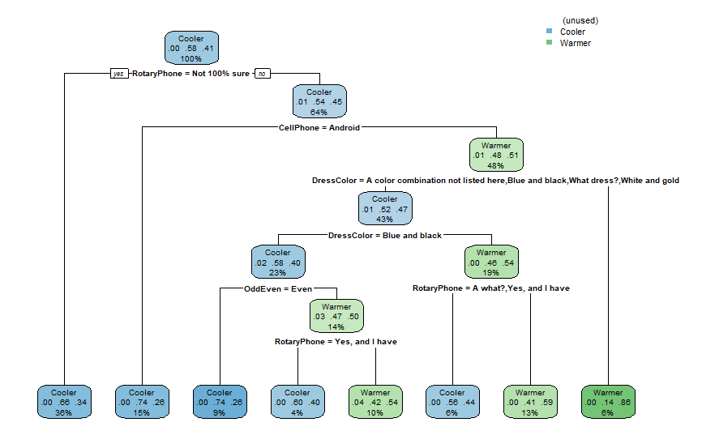
Tree 2: Thermostat Temperature
Dependent Variable: ThermostatTemperature
Independent Variables:
OddEven
CellPhoneType
RotaryPhone
DressColor
Relative Error: 0.81553

Slide 4
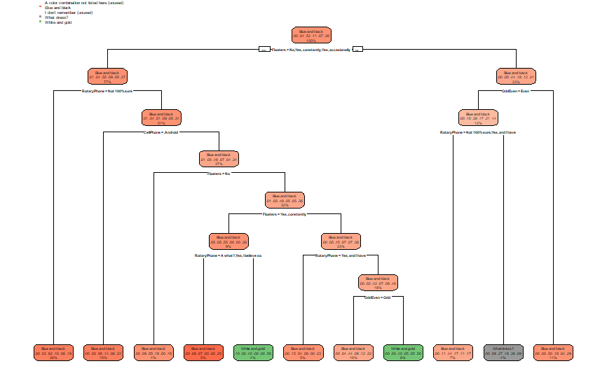
Tree 3: Dress Color
Dependent Variable: DressColor
Independent Variables:
RotaryPhone
OddEven
CellPhone
Floaters
Relative Error: 0.9661

